Slide 1
How to use Blocksi in your classroom
A series of videos and screenshots

Slide 2
What is the Teacher Dashboard Classroom Management?
The Blocksi Teacher Dashboard is a Chromebook Management system for teachers who wants to assist students on chromebooks while in their class, while at the same time monitor their screen, collect analytics and enforce a filtering policy in order to either run assessments with limited internet resources or just block or unblock access to certain materials on the internet for pedagogy and curriculum purposes. The teacher dashboard runs only during the class session for a limited amount of time. When it ends the enforced new filtering policy falls back to the administrator filtering policy

Slide 5
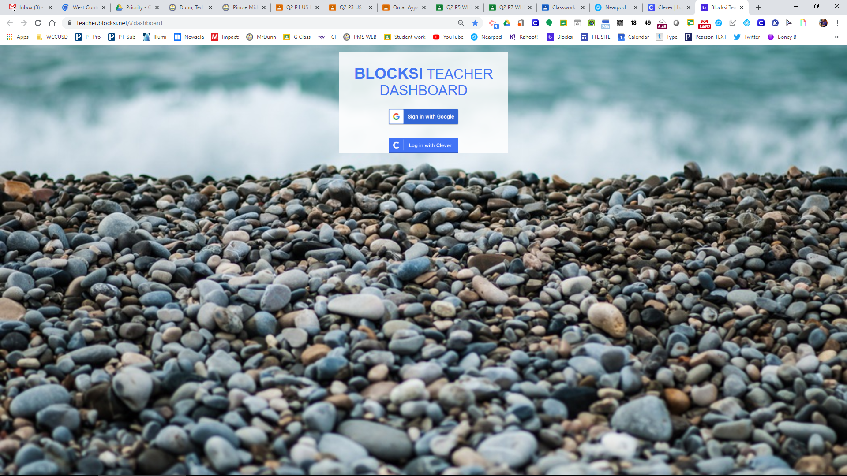
How to find Blocksi https://teacher.blocksi.net/#dashboard

Slide 6
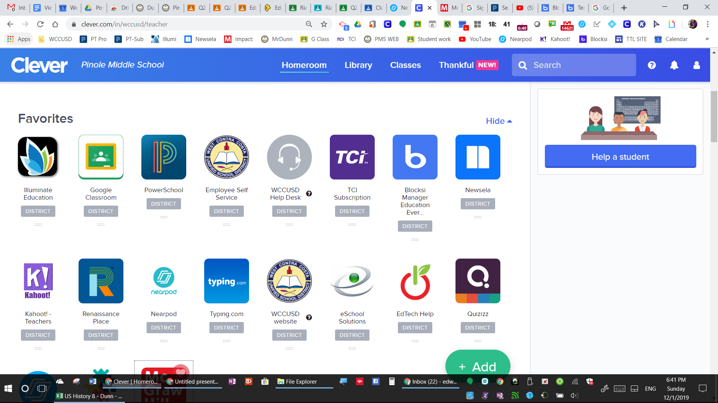

Slide 7
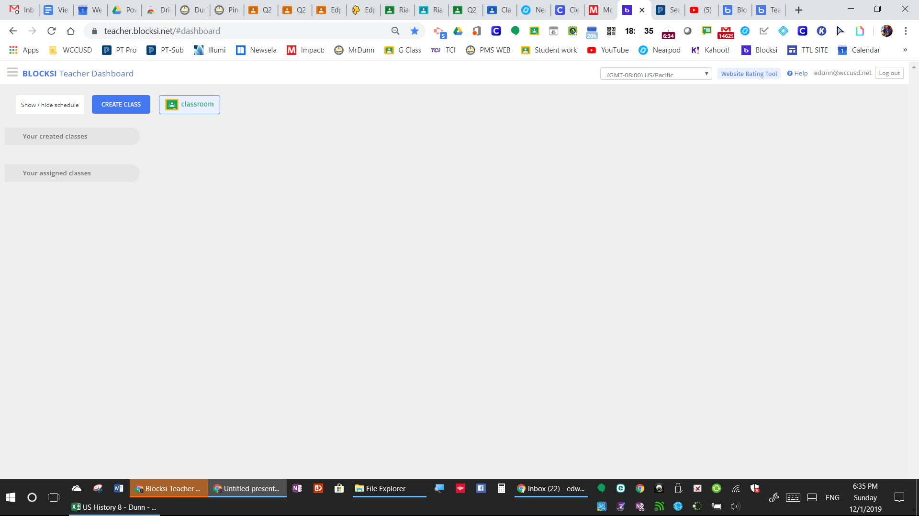
How to create your classes on Blocksi - G-Classroom

Slide 8
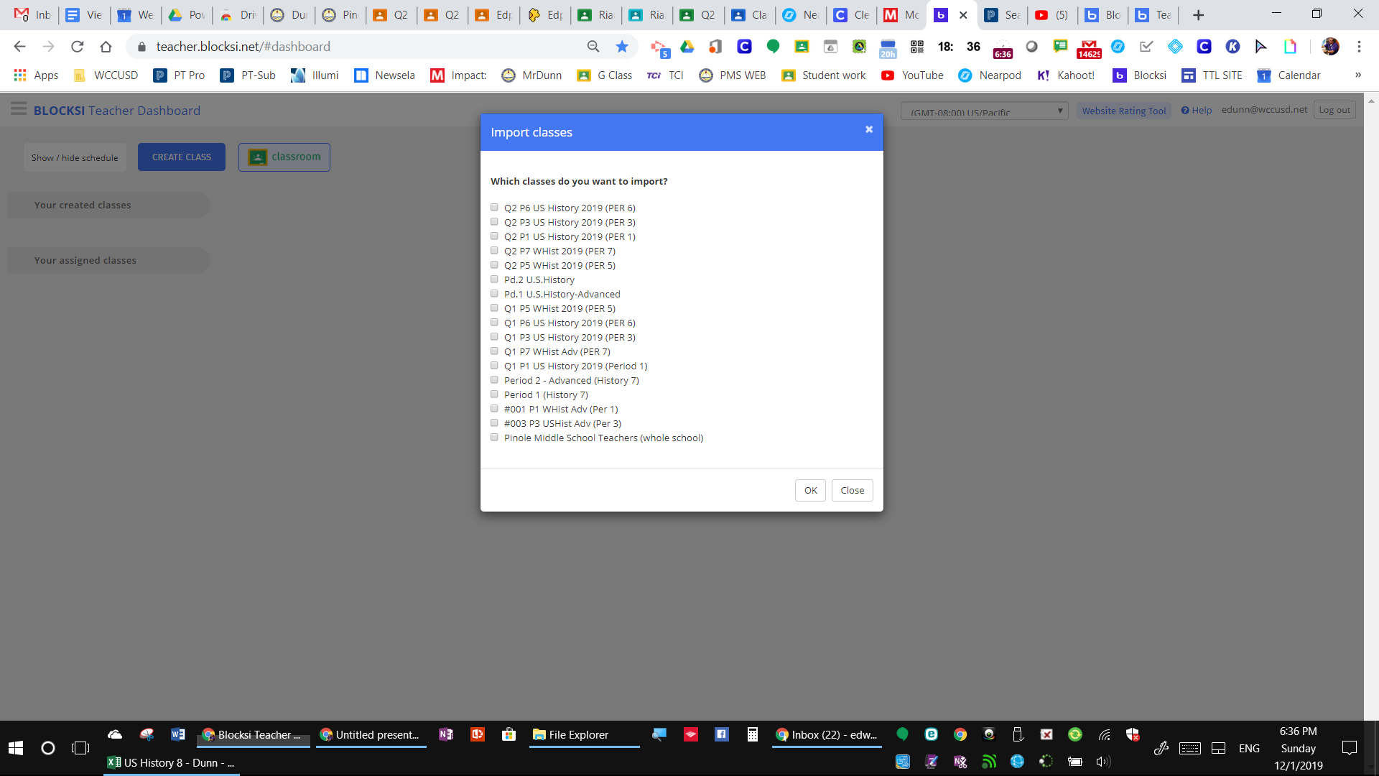

Slide 9
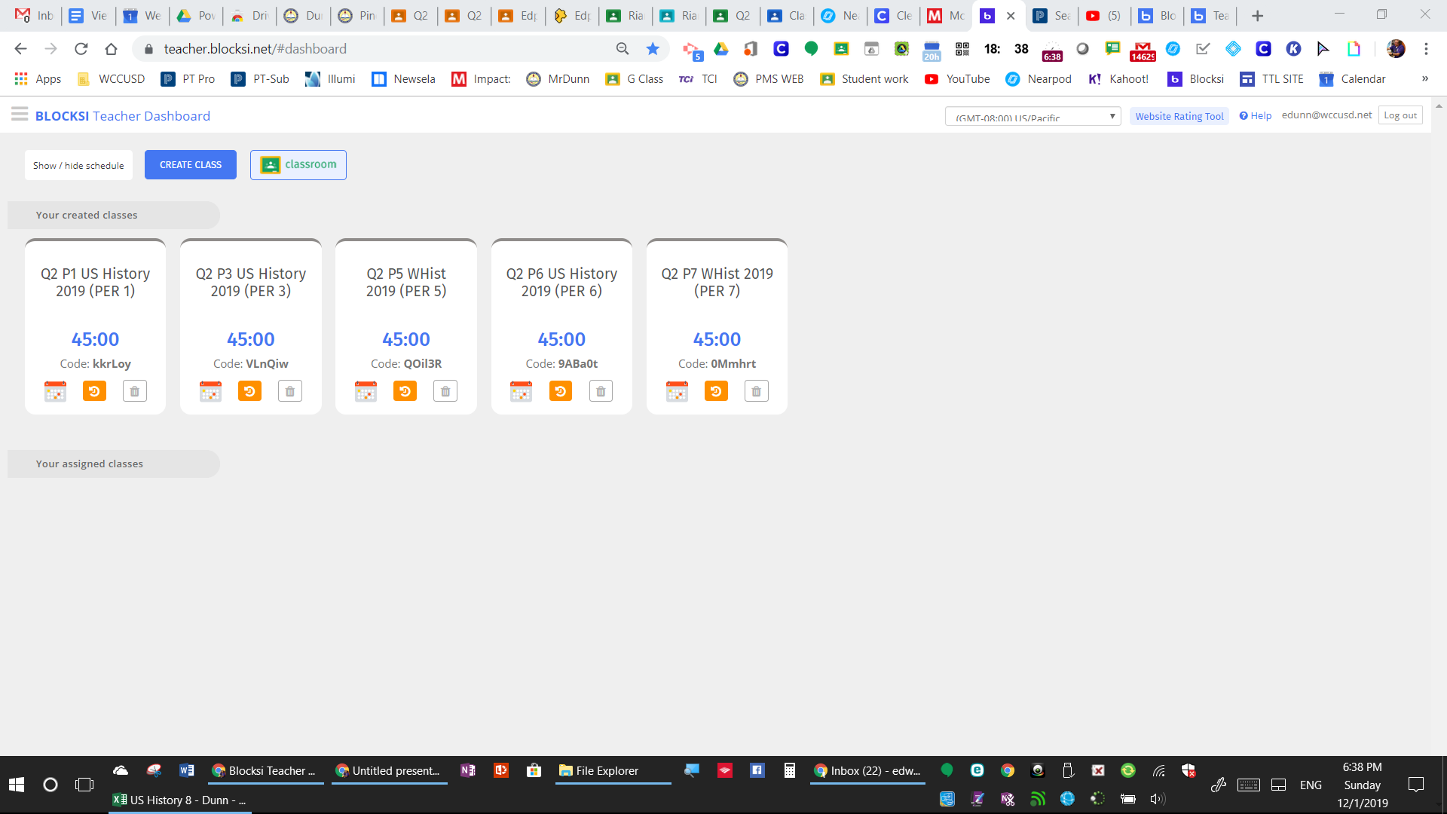

Slide 10
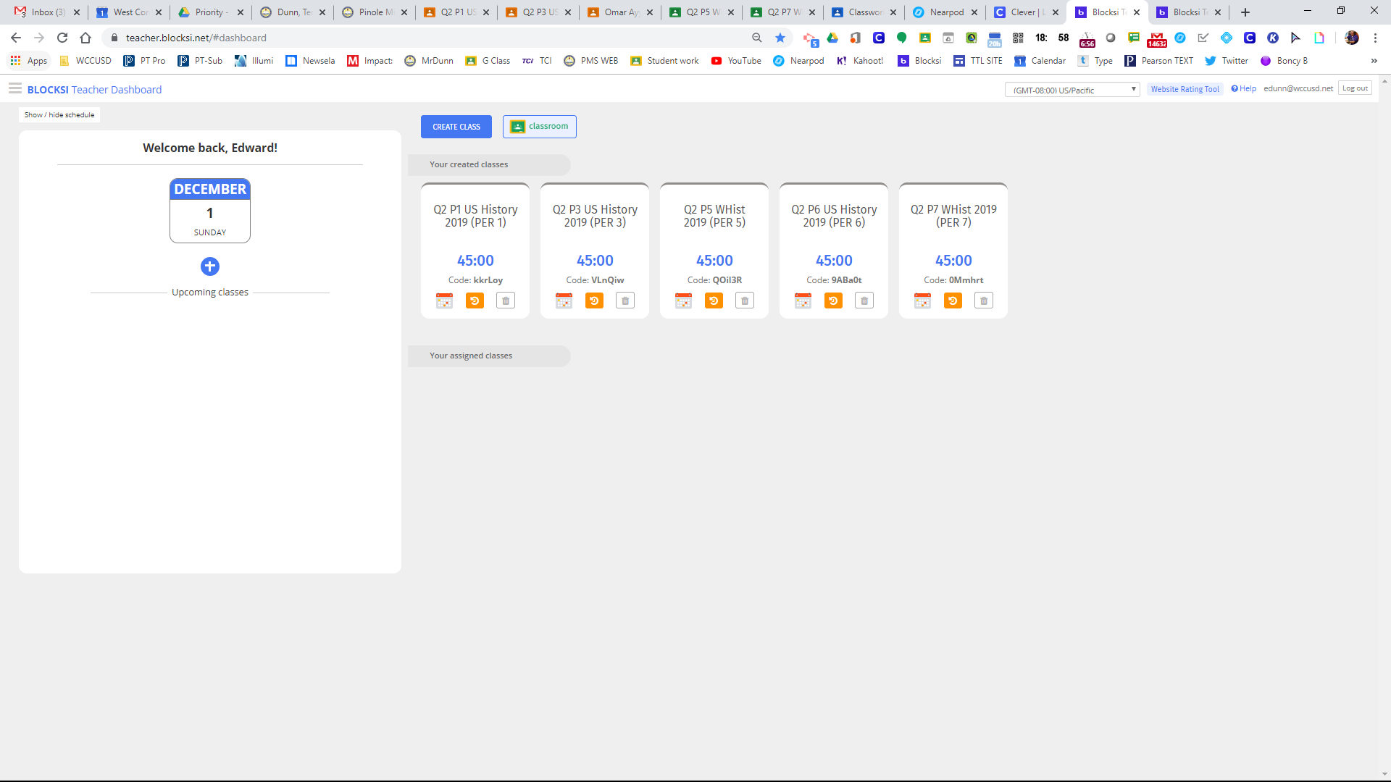

Slide 11
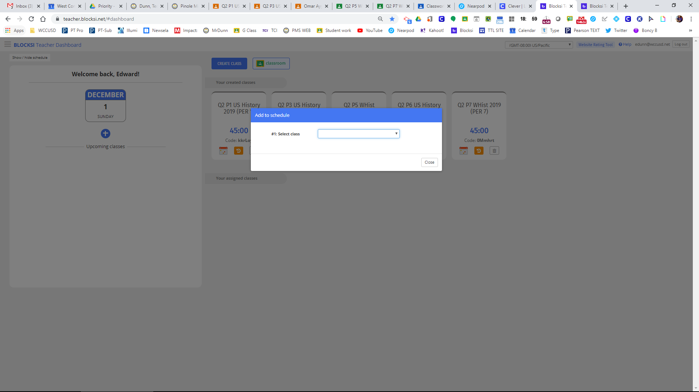

Slide 12
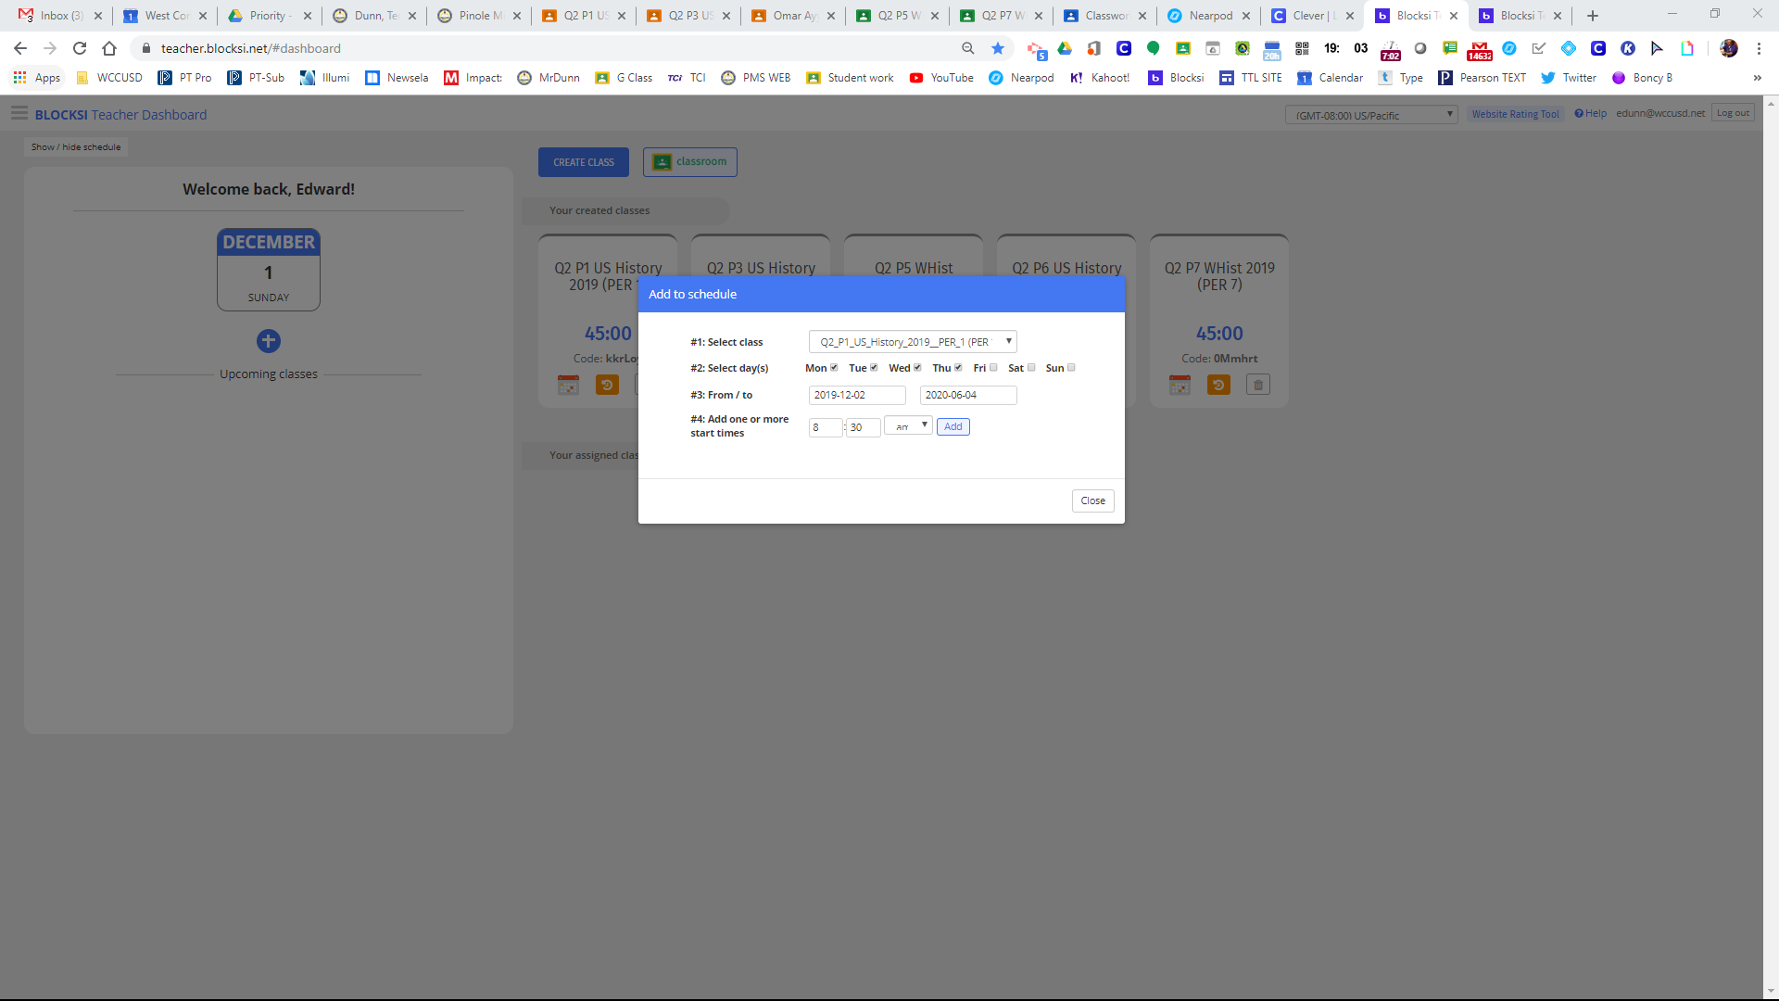

Slide 13
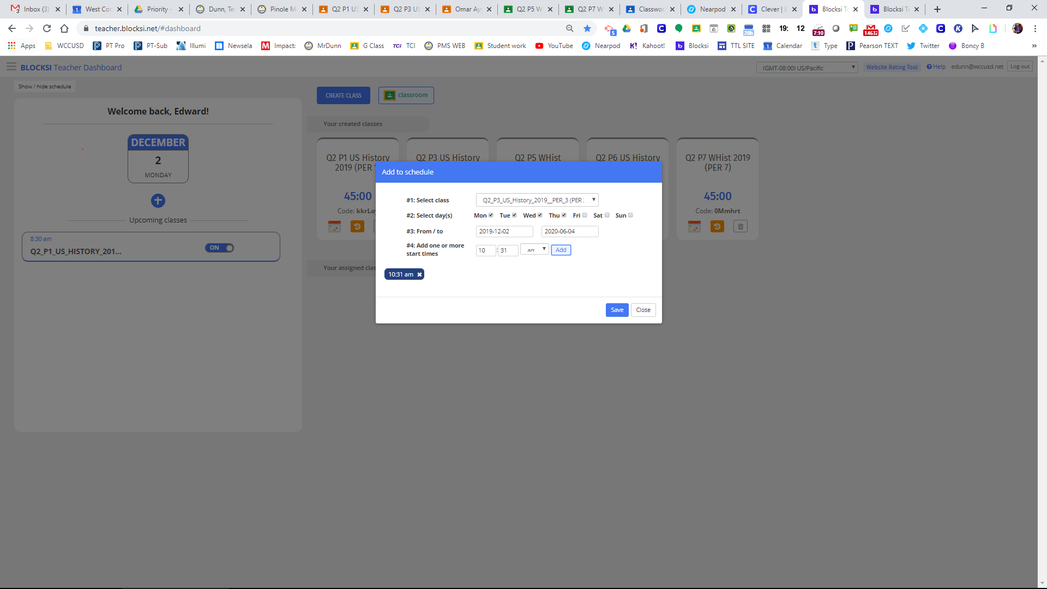

Slide 14
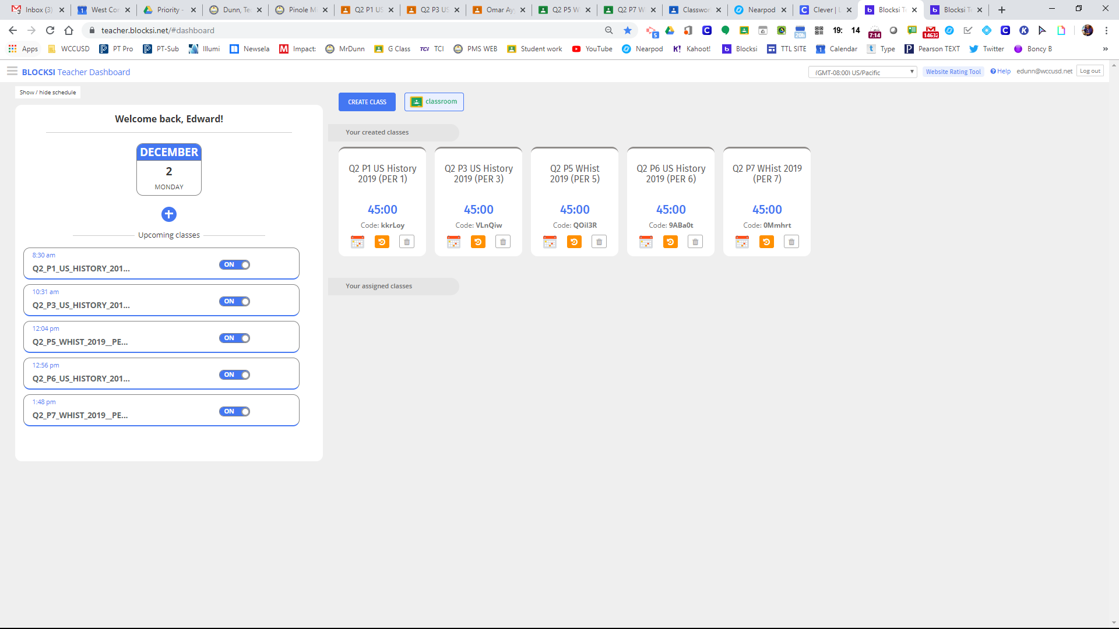
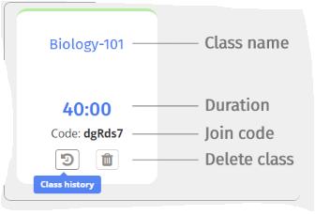

Slide 15
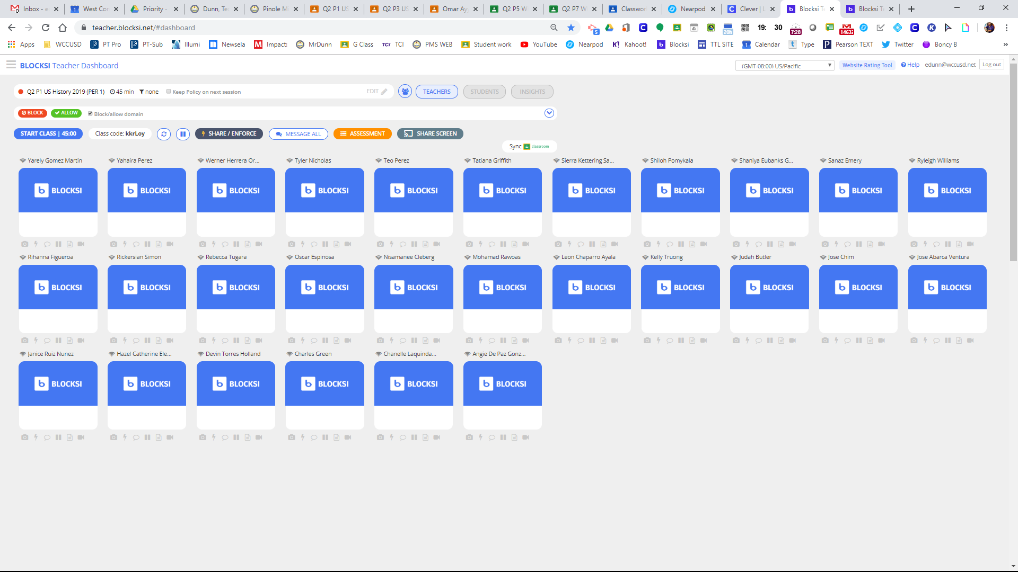

Slide 16
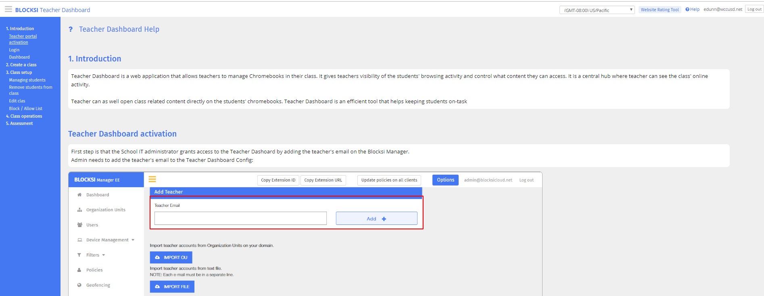
All this can be found in the ?Help tab

Slide 17
Important information about top of class setup

Slide 18
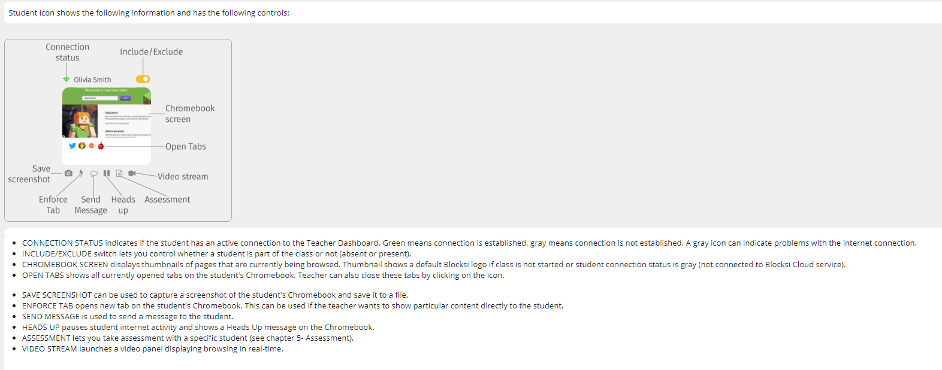
Student Icons

Slide 19
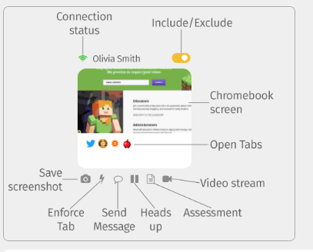

Slide 20
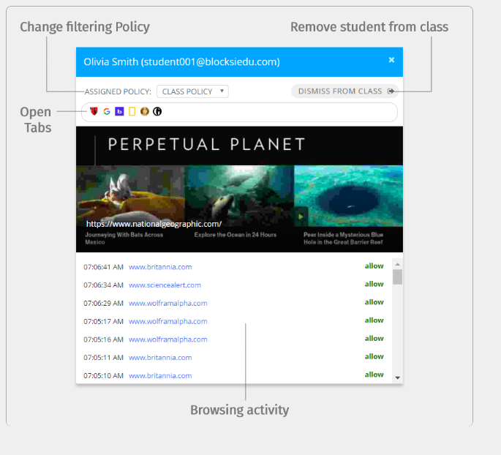

Slide 21
How to block or allow only

Slide 22
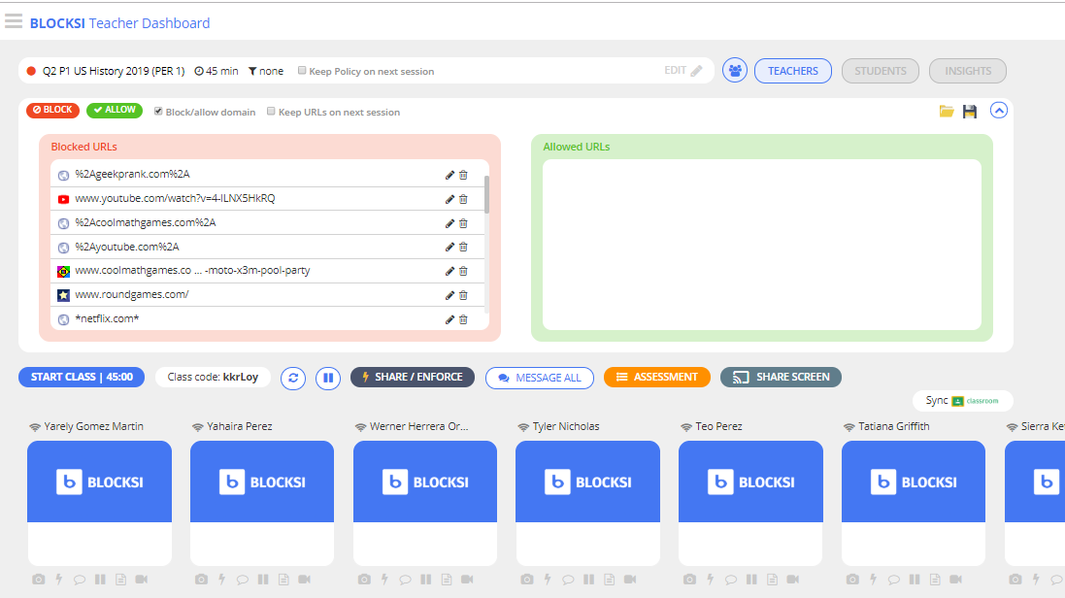

Slide 23
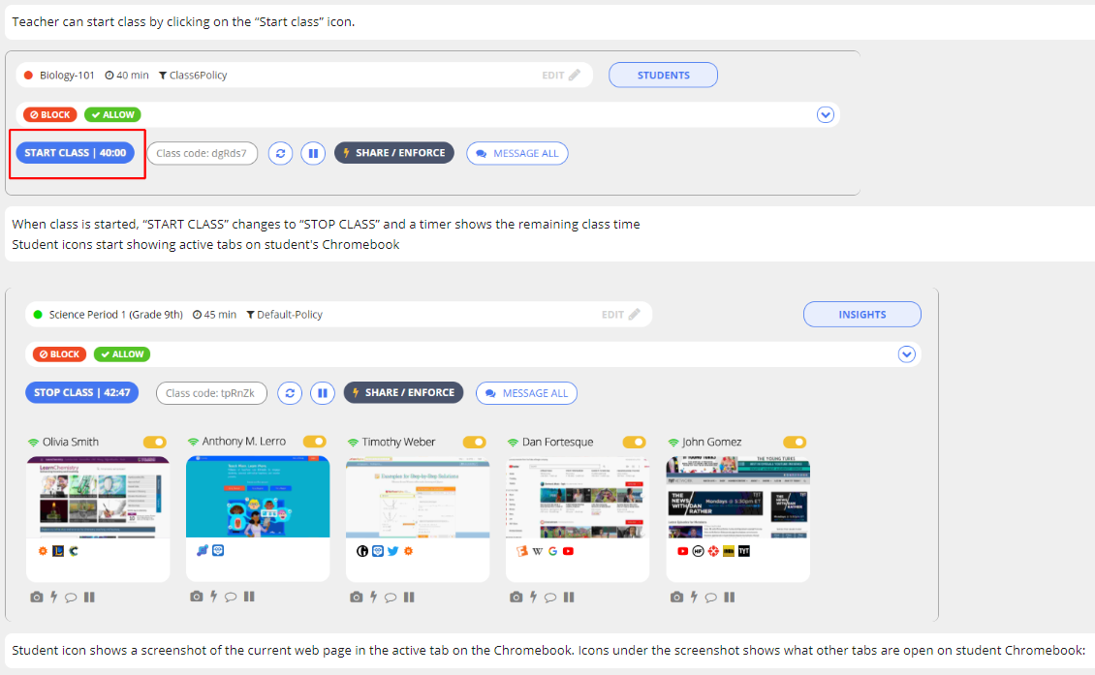

Slide 24
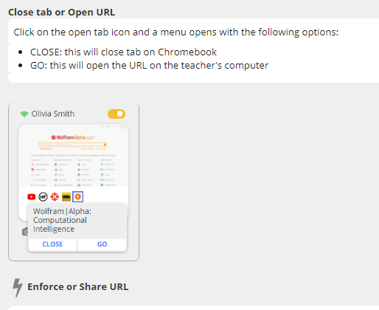
You can also block from here and add the
Website to the block list on the same box

Slide 25
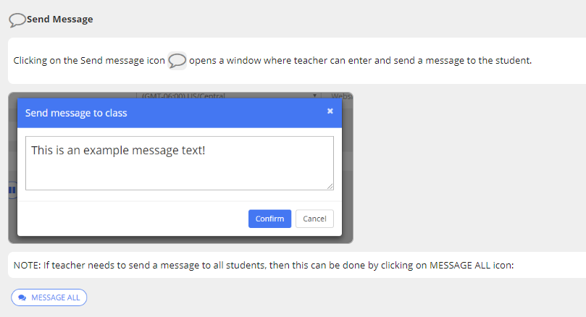

Slide 26
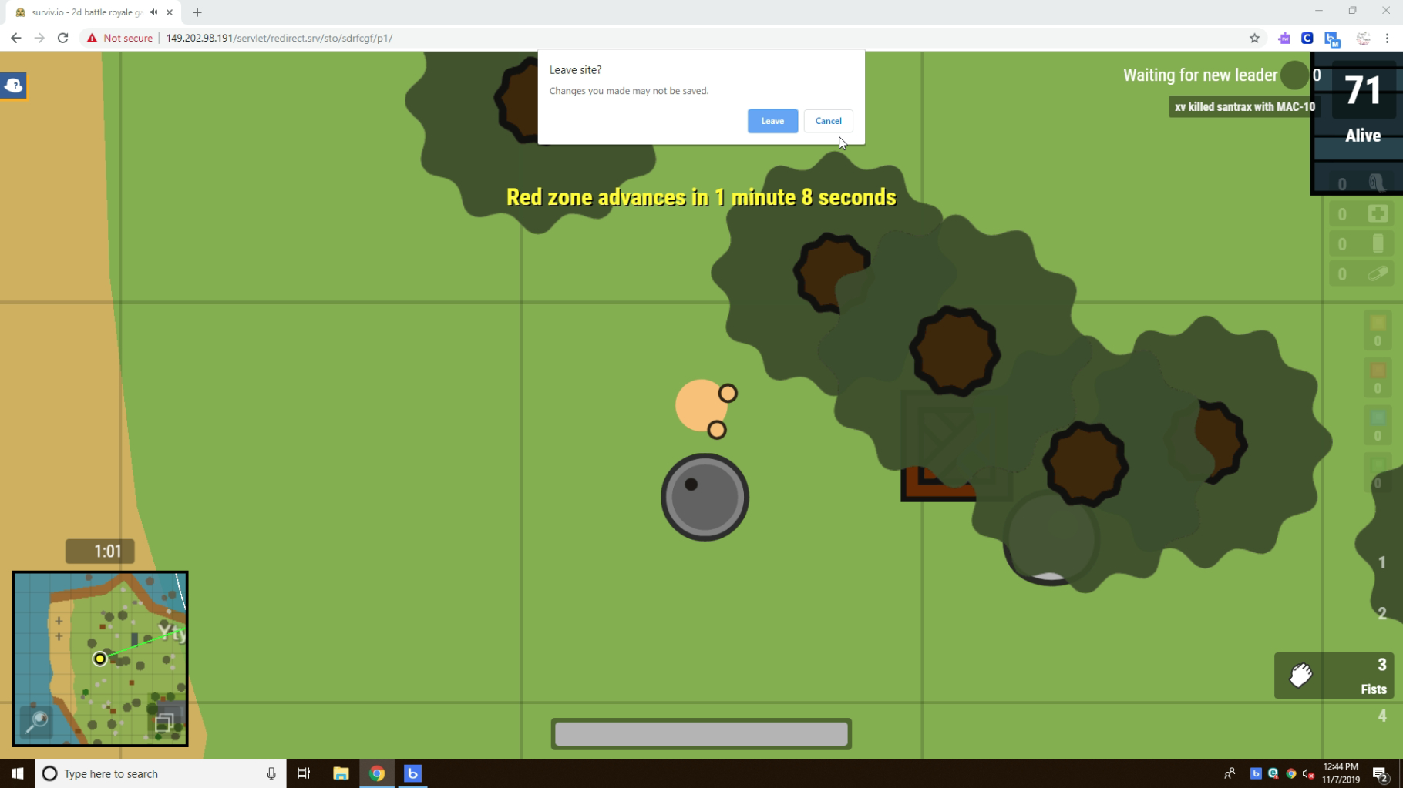
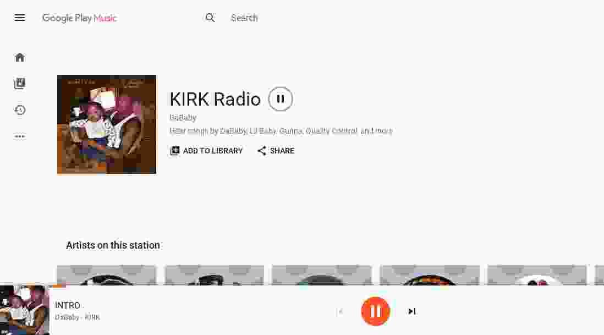

Slide 27
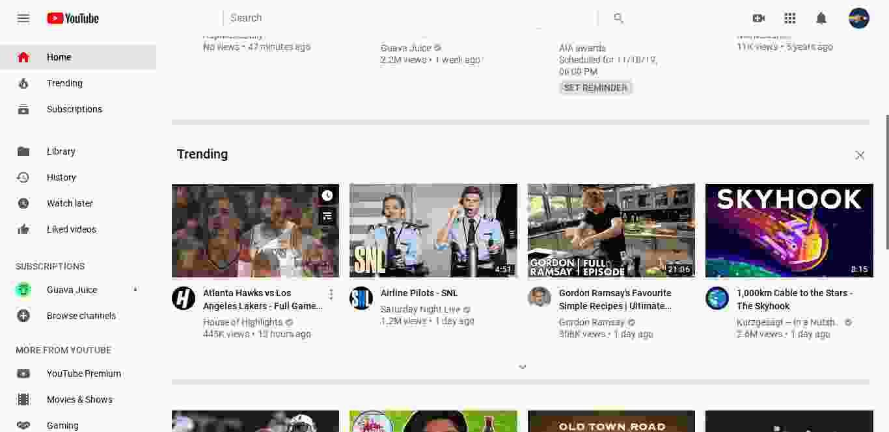
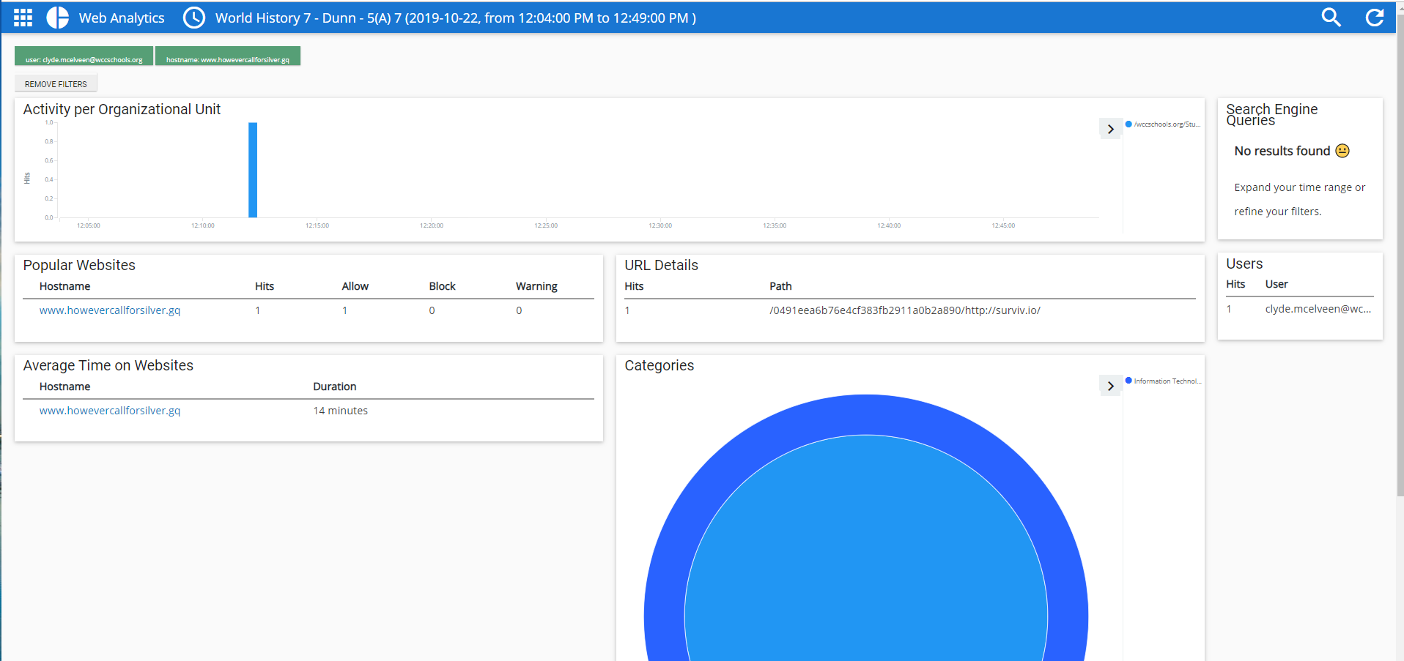

Slide 29
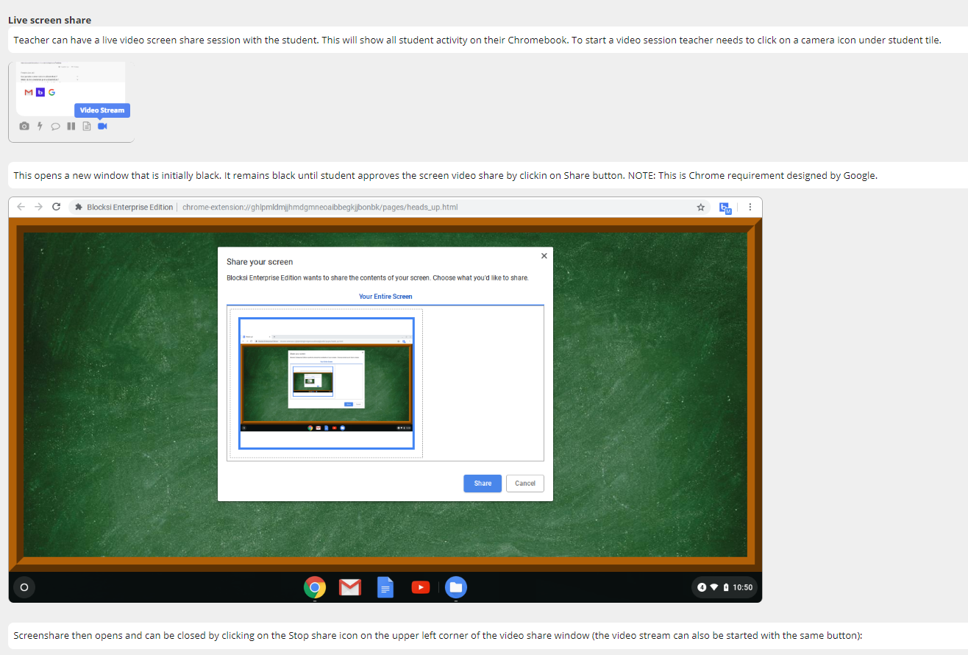

Slide 30
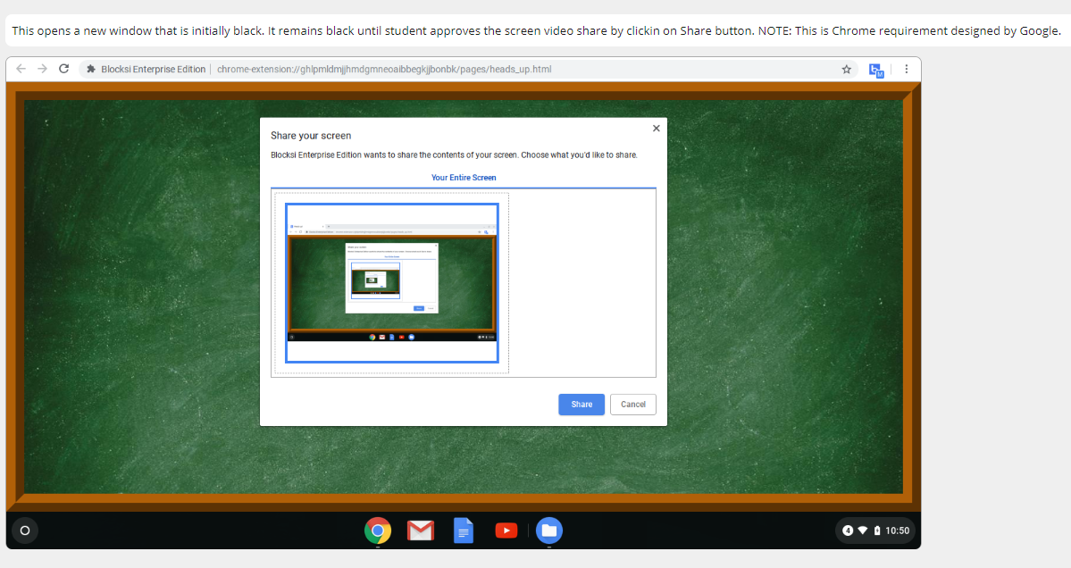

Slide 31
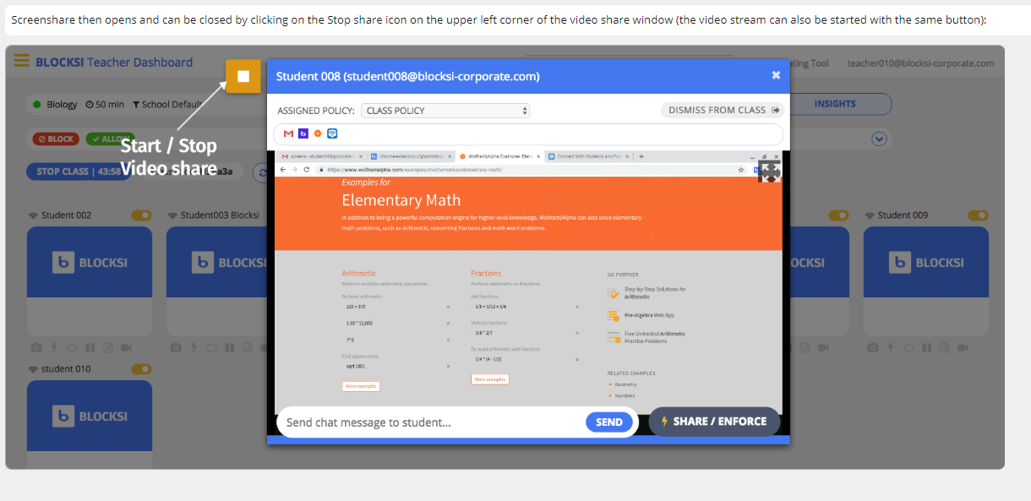

Slide 32
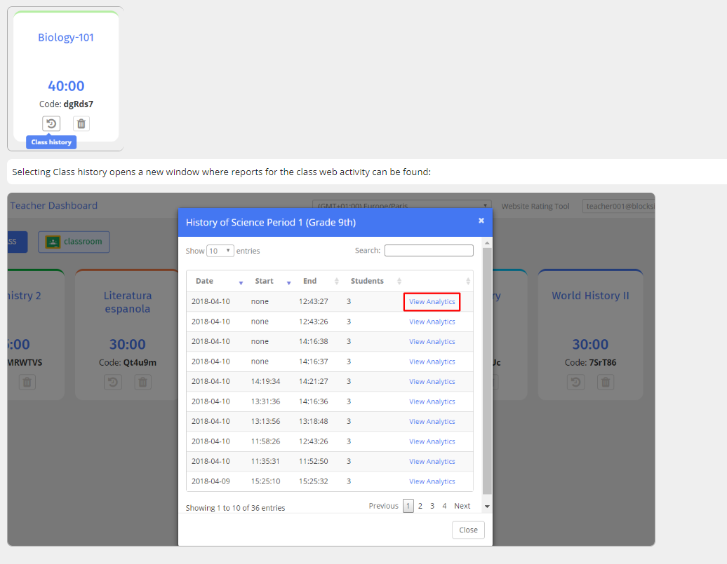

Slide 33
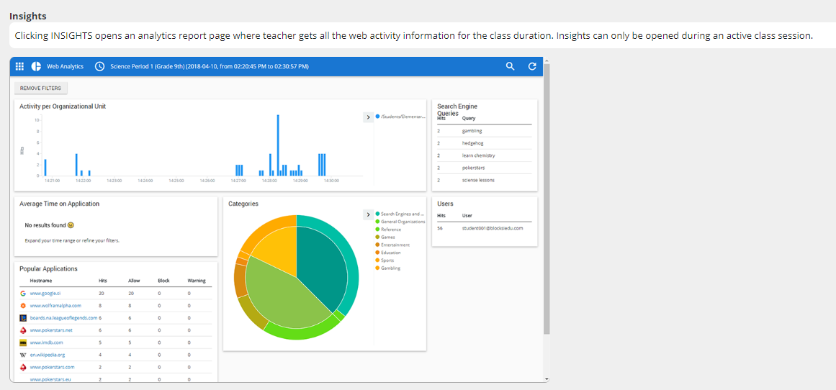

Slide 34
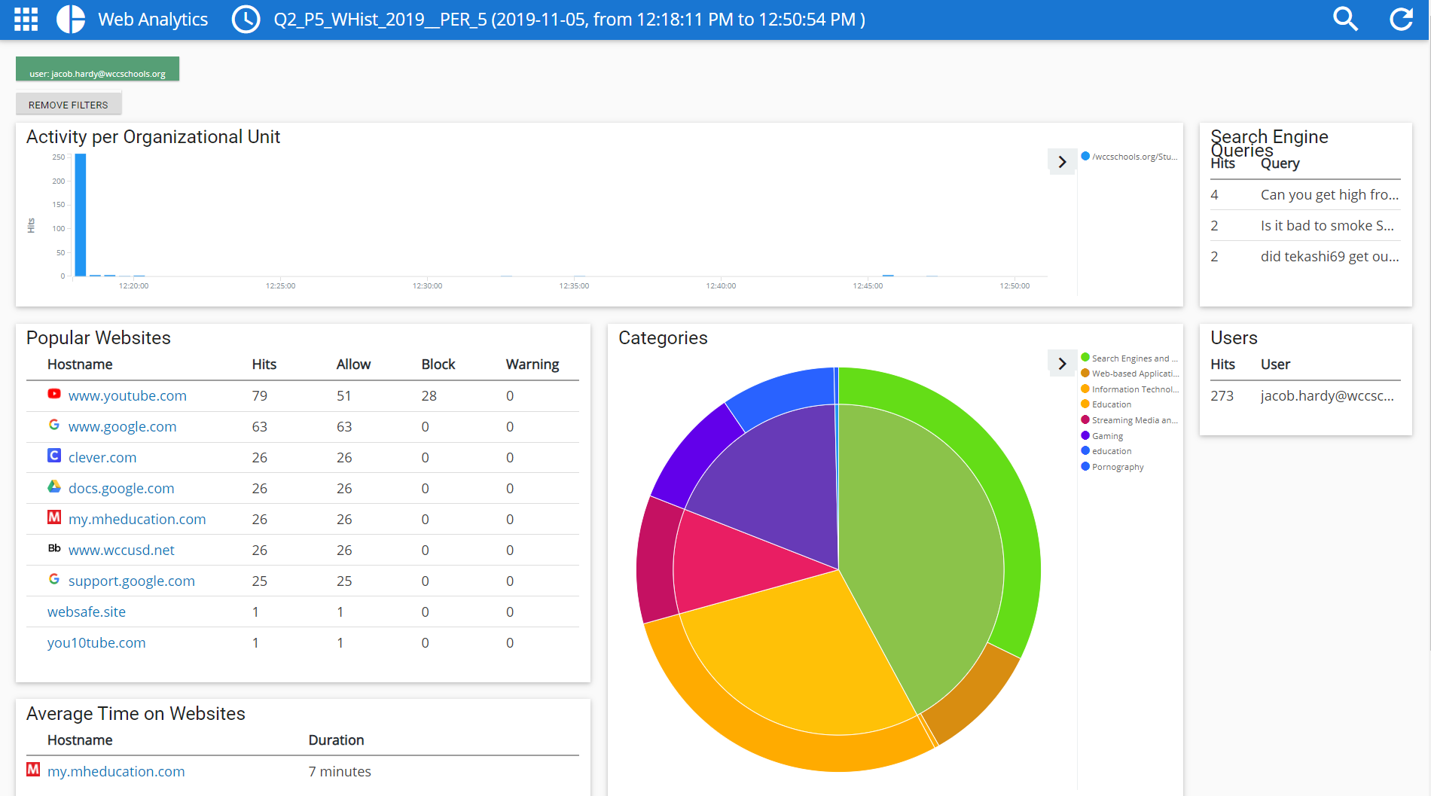

Slide 36
example of district usage
student on Create.Kahoot.it

